Slide 1
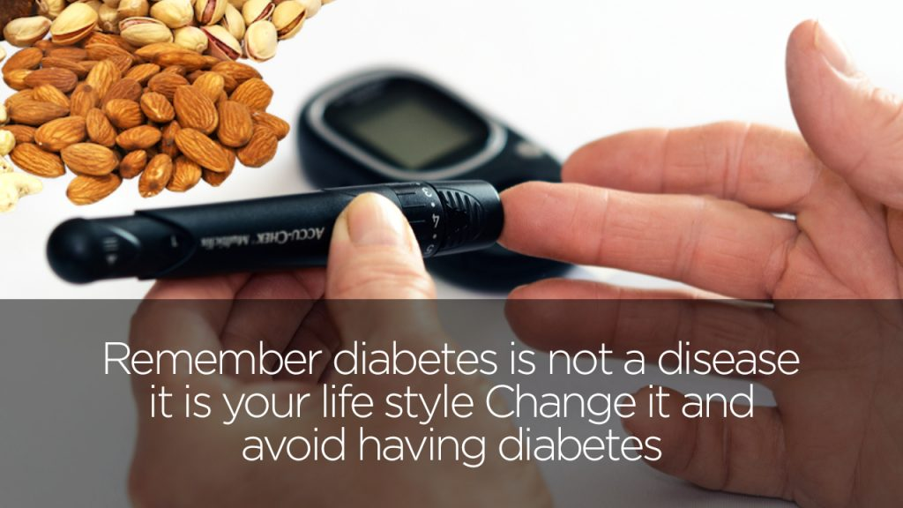
HEALTHCARE DIABETES ANALYSIS
This Photo by Unknown Author is licensed under CC BY-NC

Slide 2


INTRODUCTION
This dataset is provided by DCA. This project aimed at diagnostically predict whether a patient has diabetes based on certain diagnostic measurements included in the dataset.
Microsoft Excel was used for analysis and Power BI for visualization.

Slide 3

PROCESS WORKFLOW
Data Collection
Data Cleaning
Insights & Analysis
Data Visualization
Recommendation & Conclusion

Slide 4
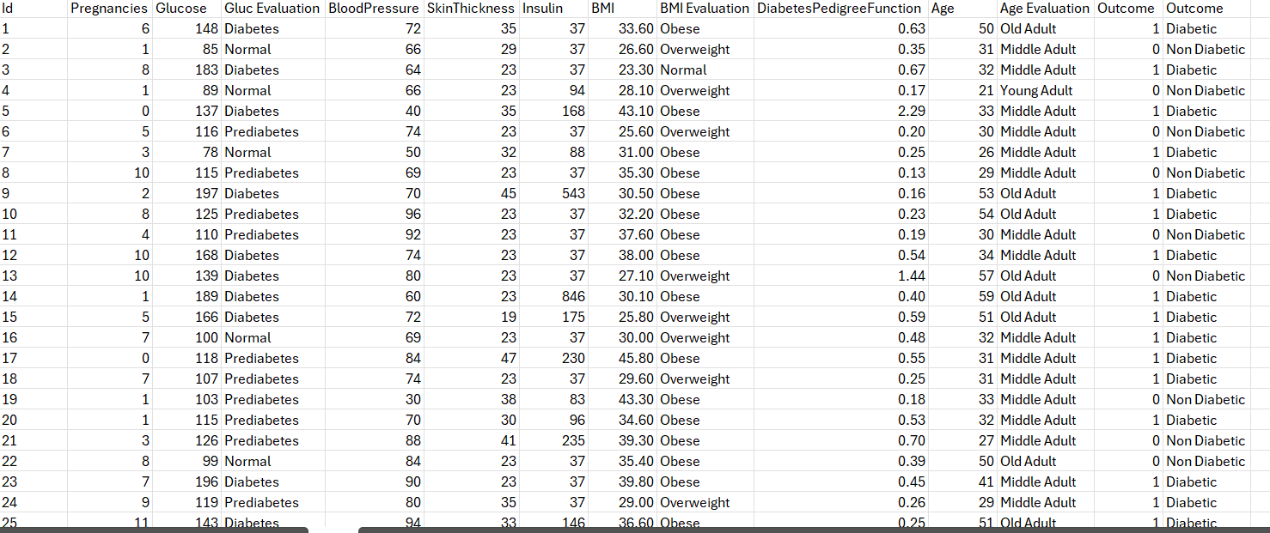
DATASET

Slide 5
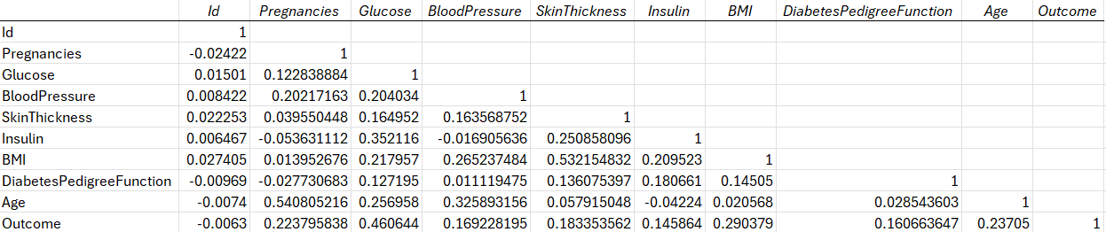
CORRELATION ANALYSIS
The analysis showed that glucose had the highest positive correlation with the
outcome, followed by body mass index (BMI), age and pregnancies.
The least positive correlation with the outcome were identified with Insulin,
Blood pressure, Skin thickness, and DiabetesPedigreefunction.
According to their correlation coefficients, the relationship
Suggests that any variable may impact the outcome of diabetes.
.

Slide 6
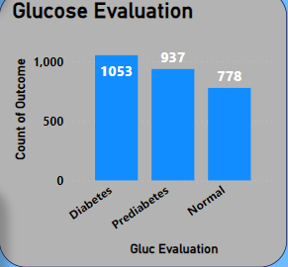

Glucose EVALUATION
In this chart we have 1053 that are diabetic, 937are prediabetes and 778 are normal due to their glucose evaluation.

Slide 7
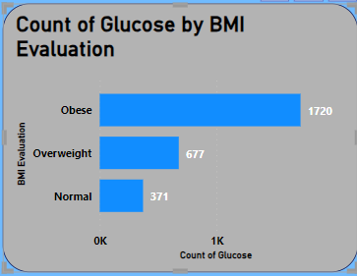
BMI EVALUATION
In this chart we have 1720 that are obese and have high glucose, 677are overweight and 371 are normal based on their glucose evaluation.

Slide 8
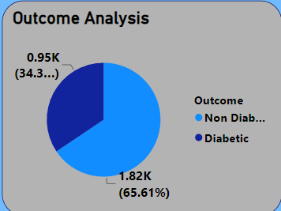
OUTCOME ANALYSIS
Out of the entire population, 65.61% had
diabetes, while 34.39% did not have diabetes.

Slide 9
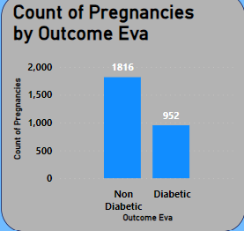
Pregnancies Analysis
During pregnancies we have 952 that are diagonised with diabetes and 1816 that are non-diabetic.

Slide 10
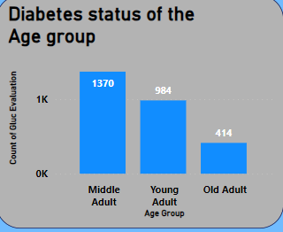
DIABETES STATUS OF THE AGE GROUP
Young adults with diabetes numbered 262, while 388 young adults did not have diabetes and 334 with Prediabetes. There were 551 middle-aged adults with diabetes, and 332 middle-aged adults without diabetes and 487 prediabetes. In the case of old adults, 240 had diabetes, 58 did not have diabetes and 116 that are prediabetes.

Slide 11
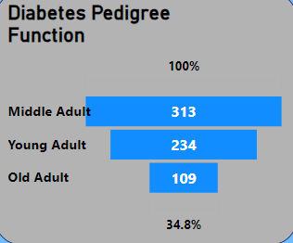
DIABETES STATUS by Diabetes Pedigree function
The chart indicated that, based on their Diabetes Pedigree function, 109 old adult are diabetic, 234 young adult were diabetic and 313 middle adult are diabetic

Slide 12
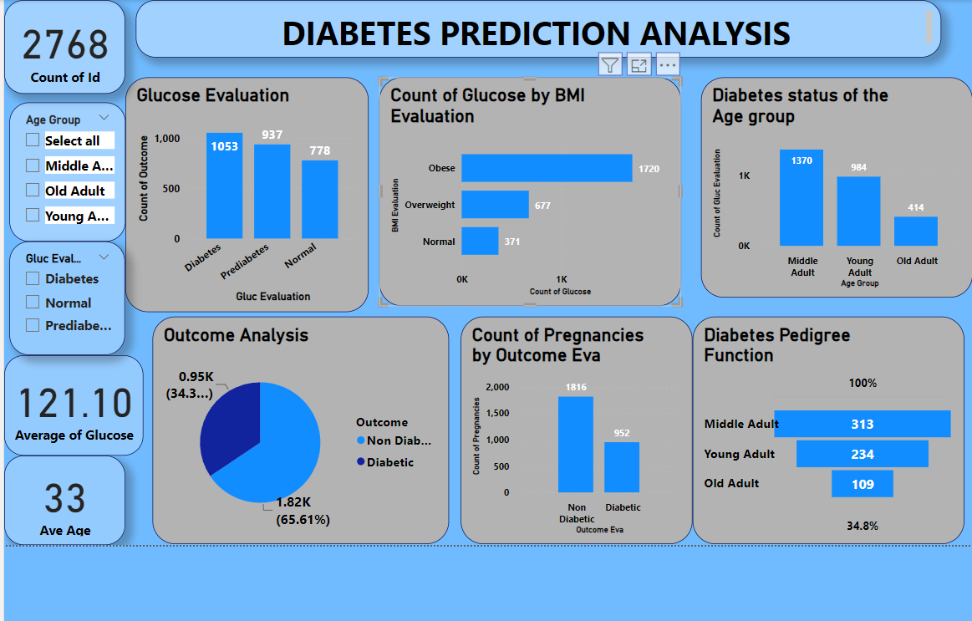

Slide 13

RECOMMENDATION
The number of patients diagnosed by diabetes should be educated of change of their diets. The BMI group with diabetes should be advised to exercise regularly. The age group with the highest bloodpressure should be advised to reduce their salt intake.

Slide 14

CONCLUSION
This analysis strongly suggests that elevated blood glucose levels are a primary driver of the condition. However, it’s important to recognize that other health-related factors, including Body mass index(BMI), age, and the Diabetes Pedigree function, can also play a significant role in diabetes occurrence.

Slide 15
THANK YOU FOR LISTENING

